Slide 1
Alignment on Ways of Working –
Work Stream 1
Engagement Manager
AWS Professional Services

Slide 2
Agenda
Delivery Framework
Ceremonies & Cadence
Tooling
Backlog – Story Creation
RACI
Definition of Done

Slide 3

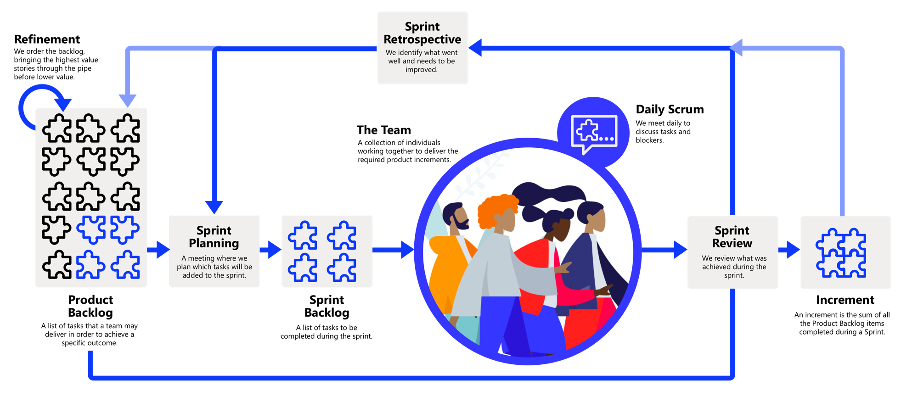
Deliver Framework
Sprint duration
2 Weeks with mid week start and end
3

Slide 4
Ceremonies and Cadence
Sprint Planning and Retrospective
Daily Scrums
Sprint Review
Who: Core Scrum Team
What: Sets the plan for the next sprint
When: Every 2nd Wednesday
Who: Each Scrum team
What: Sets the plan for the day. Discuss blockers.
When: Daily time boxed to 15 minutes
Who: Core Scrum Team + invited leads and Customer Outcome Owner
What: Inspection of work completed in a sprint
When: Every 2nd Wednesday
Backlog Refinement
Program Scrum of Scrums
Who: Outcome Owner / Scrum Team
What: Backlog review, enhancement, prioritisation
When: 1 session with Outcome Owner and Stream Lead, and 1 session a week for Scrum Team
Who: Outcome Owners, Cloud Architect Lead, Engagement Manager, Stream Tech Lead
What: Escalation of blockers to program level
When: Every Tuesday and Thursday

Slide 5
Tooling
Confluence
SharePoint
Who: Scrum Team
What: Documentation of information relating to application and the Dojos
Link:
Who: Scrum Team and greater program members
What: Documentation storage for Project and Stream files
Link:
JIRA
Slack
Who: Scrum Team
What: Day to day management of activities for the dojo
Link:
Who: AWS Team Members
What: Collaboration on ‘#’ and ‘#’ channels
Teams
Who: Scrum Team and greater program members
What: Collaboration and document sharing space
Link: Reach out to Engagement Manager if not on Teams

Slide 6
Backlog – Story Creation
Owner: The Outcome Owner
Scrum Master: Facilities backlog refinement
Story writers: Outcome Owner, Stream leads and SMEs
Stories are refined by the dojo leads with support from the developers / testers, in readiness to go into a Sprint. Stories can be estimated during the weekly Backlog refinement meeting(s).
A story is ready to go into a Sprint if it has;
Title
Epic Link
Description – in format ‘As a’, ‘I want’, ‘So that’
Acceptance Criteria – in format of Given, When, Then
Story Point Estimation
Story dependences identified (if known)
Priority determined by the Outcome Owner

Slide 7

Backlog – Story Creation
Story deliverables: Each story may have 1 or more of these components:
Code checked in and reviewed by a peer
Stakeholders including the Outcome Owner have reviewed and accepted the work
Unit test passed
Documentation / Diagrams updated and published on the project Repo (Teams)
Operations is integrated
Security is integrated
Solution demonstrated to the buyer in non-production environment
Acceptance criteria verified complete by the buyer

Slide 8
Backlog – Story Estimation
T-Shirt sizing and Fibonacci
Fibonacci scale consists of a sequence of numbers used for estimating the relative size of user stories in points. The Fibonacci sequence consists of numbers that are the summation of the two preceding numbers, starting with (0, 1, 2, 3, 5, 8 and 13).
T-Shirt Size | Fibonacci Equivalence | Considerations
XS | 2 | Less than half a day, This is likely a sub-task and not a story.
S | 3 | Takes between 1-2 days, clear pathway for work to be completed, no external support required
M | 5 | Takes 3-5 days, pathway for work to be completed but has some complexities, may require engagement with third parties or external teams from Dojo
L | 8 | Takes a sprint, complex pathway to complete work, several moving aspects to achieve completion or heavy reliance on third parties or external teams from Dojo
XL | 13 and above | If a story is a 13 we need to slice it thinner to de-risk it. We don't want to get to the end of the sprint and realise a story can’t be achieved.

Slide 9
Backlog – Issue Types
Issue Type | Issue Description
Epic | A large portion of work unified by a common objective. An Epic is usually, minimally 5 stories.
Story | User stories are brief descriptions of a feature to be delivered by the team. A user story describes an increment of value to the user/customer. User stories are written from the perspective of a user. User stories contain testable acceptance criteria. Stories and acceptance criteria is written by the dojo and endorsed by the Outcome Owner before bring brought into a sprint.
Task (Spike) | Tasks are generated for investigations or Spikes. A Spike is a time-boxed piece of work to understand unknowns and creating a pathway for building increment value. Tasks should have a clear outcome noted within the acceptance criteria to minimize spiraling into analysis/investigation paralyses.
Sub-Task | A piece of work that supports a greater increment of a build. A sub-tasks is listed under a Story or a task.
Bug | A bug is an identified fault in a build. A bug description shall note the issue identified and any details that will ensure resolution of the bug. Prioritisation shall be given on bug by the Outcome Owner.

Slide 10
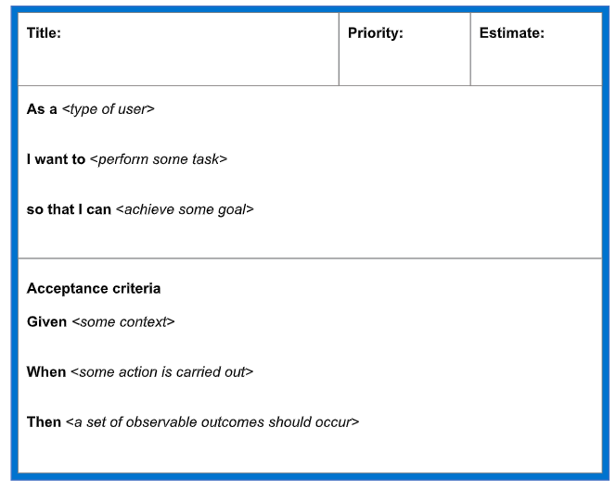
Backlog Management – Story Example
Example of a Story
Title:
AXXX appName– Identify domain owners and UAT resources
Description:
As a:
Outcome Owner
I want to:
Identify the domain owner and UAT resources for XXX
So that:
I can have clear ownership, decision on application treatment plan and ensure availability of resources for UAT at the required timeframe
Acceptance Criteria:
Given:
appName is in scope for Work stream – 1 for discovery, the Outcome Owner has been able to identify the Domain Owner and required UAT resources.
When:
successful the Outcome Owner can
Then:
Record the information in Confluence
Engage the Domain Owner for decision making
Engage the UAT resources for UAT

Slide 11
RACI
R - Responsible | Person working on activity
A - Accountable | Person with decision authority
C - Consulted | Stakeholder who should be contributing to the decision or activity
I - Informed | Has a need to know about the decision or activity
Function | Outcome Owner (Customer) | EM/ Scrum Master (AWS) | Tech Leads/ Stream Leads (AWS) | Cloud Architect (AWS) | Developers (AWS) | Test Analyst (Partner) | SME (Partner / Customer) | Lead Dojo (AWS, Partner, Customer)
Stream Governance/Reporting | C | AR | C | C | C | C | I | I
Product Backlog Development | AR | C | R | R | R | R | R | I
Customer Partner Engagement & Co-ordination | A | C | C | R | I | I | R | I
AWS Partner Engagement & Co-ordination | A | R | C | R | C | C | C | I
Application Treatment Plans | C | C | R | AR | C | I | C | IC
Documentation of current e2e state | C | C | R | R | RC | C | RC | IC
Source Code Analysis/Requirements | I | C | A | C | R | I | C | I
Cloud Architecture Solution Design | C | I | R | RC | C | C | C | C
Development | C | I | A | C | R | C | C | I
Peer Reviews - QA | I | C | A | R | R | I | C | I
e2e Integration – Partner Supported | I | C | A | C | R | R | C | I
e2e Integration – Other | I | C | C | C | R | R | C | I
Raise (Prod) CR and seek approvals | C | I | A | C | R | C | C | I
Deployment guidance & best practice | C | R | I | R | C | I | C | C
Test Plan | C | C | C | C | C | R | C | I
Test Case Creation | C | I | I | C | C | R | C | I
Automation Test Creation | C | I | C | C | C | R | C | I
System Integration Test Execution | C | I | C | C | C | R | C | I
User Acceptance Testing | A | C | R | C | C | C | R | I
Post Verification Testing (Go-Live) | A | C | R | C | I | R | R | C
Communications, Change Comms, User Training - internal users | AR | C | C | I | C | C | R | C
Decommissioning | A | R | R | R | I | I | R | C
Implementation | C | R | AR | R | R | R | C | I
Training & Enablement | C | A | R | R | I | I | C | I
Operations Handover | C | A | R | C | R | C | R | C

Slide 12
Definition of Done (DoD)
The ‘Done’ for the Work Streams and it is used to assess when an story is complete and can move to the next delivery phase. DoD is a shared understanding within the Scrum Team on what it takes to make an application move into a new delivery phase.
Definition of Done
Unit tests passed
Automated Code Scans Passed
Code reviewed
Acceptance criteria met
Functional tests passed
Non functional requirements met
Outcome owner accepts user story or Epic as Done

